Slide 1





WELCOME TO THE BIP COURSE
Blended Intensive Programme
Warsaw University of Life Sciences - SGGW
Waste Materials Application in Civil and Environmental Engineering
4 ECTS
Online part: April 2026
On-site part: 20 – 24 April 2026

Slide 2
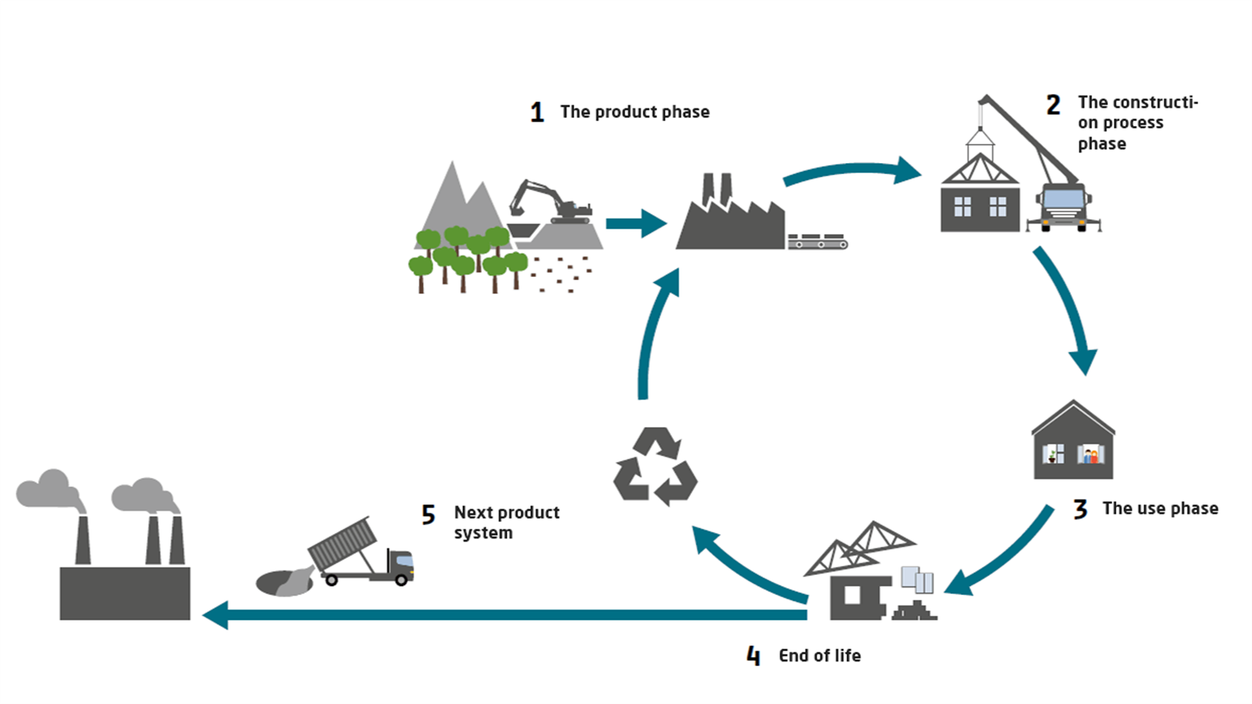
Circular economy
The building industry significantly impacts the environment through resource and energy consumption, as well as waste production. A new paradigm known as the Circular Economy (CE) holds promise for enhancing the industry's sustainability.
The building and construction sector significantly impacts the economy and environment. It contributes about 9% of the EU's GDP, providing both direct and indirect job opportunities (18 million direct jobs in the EU) while meeting society's building needs. However, it's worth noting that this sector is a major resource consumer, accounting for approximately 50% of total raw material use and 36% of global final energy consumption.
Figure 1. The figure shows a typical life cycle of a building. Here you can see the key phases and processes that are part of the cycle from production to demolition. Illustration: The Danish Transport and Construction Authority
Blended Intensive Programme
Warsaw University of Life Sciences - SGGW
Waste Materials Application in Civil and Environmental Engineering

Slide 3
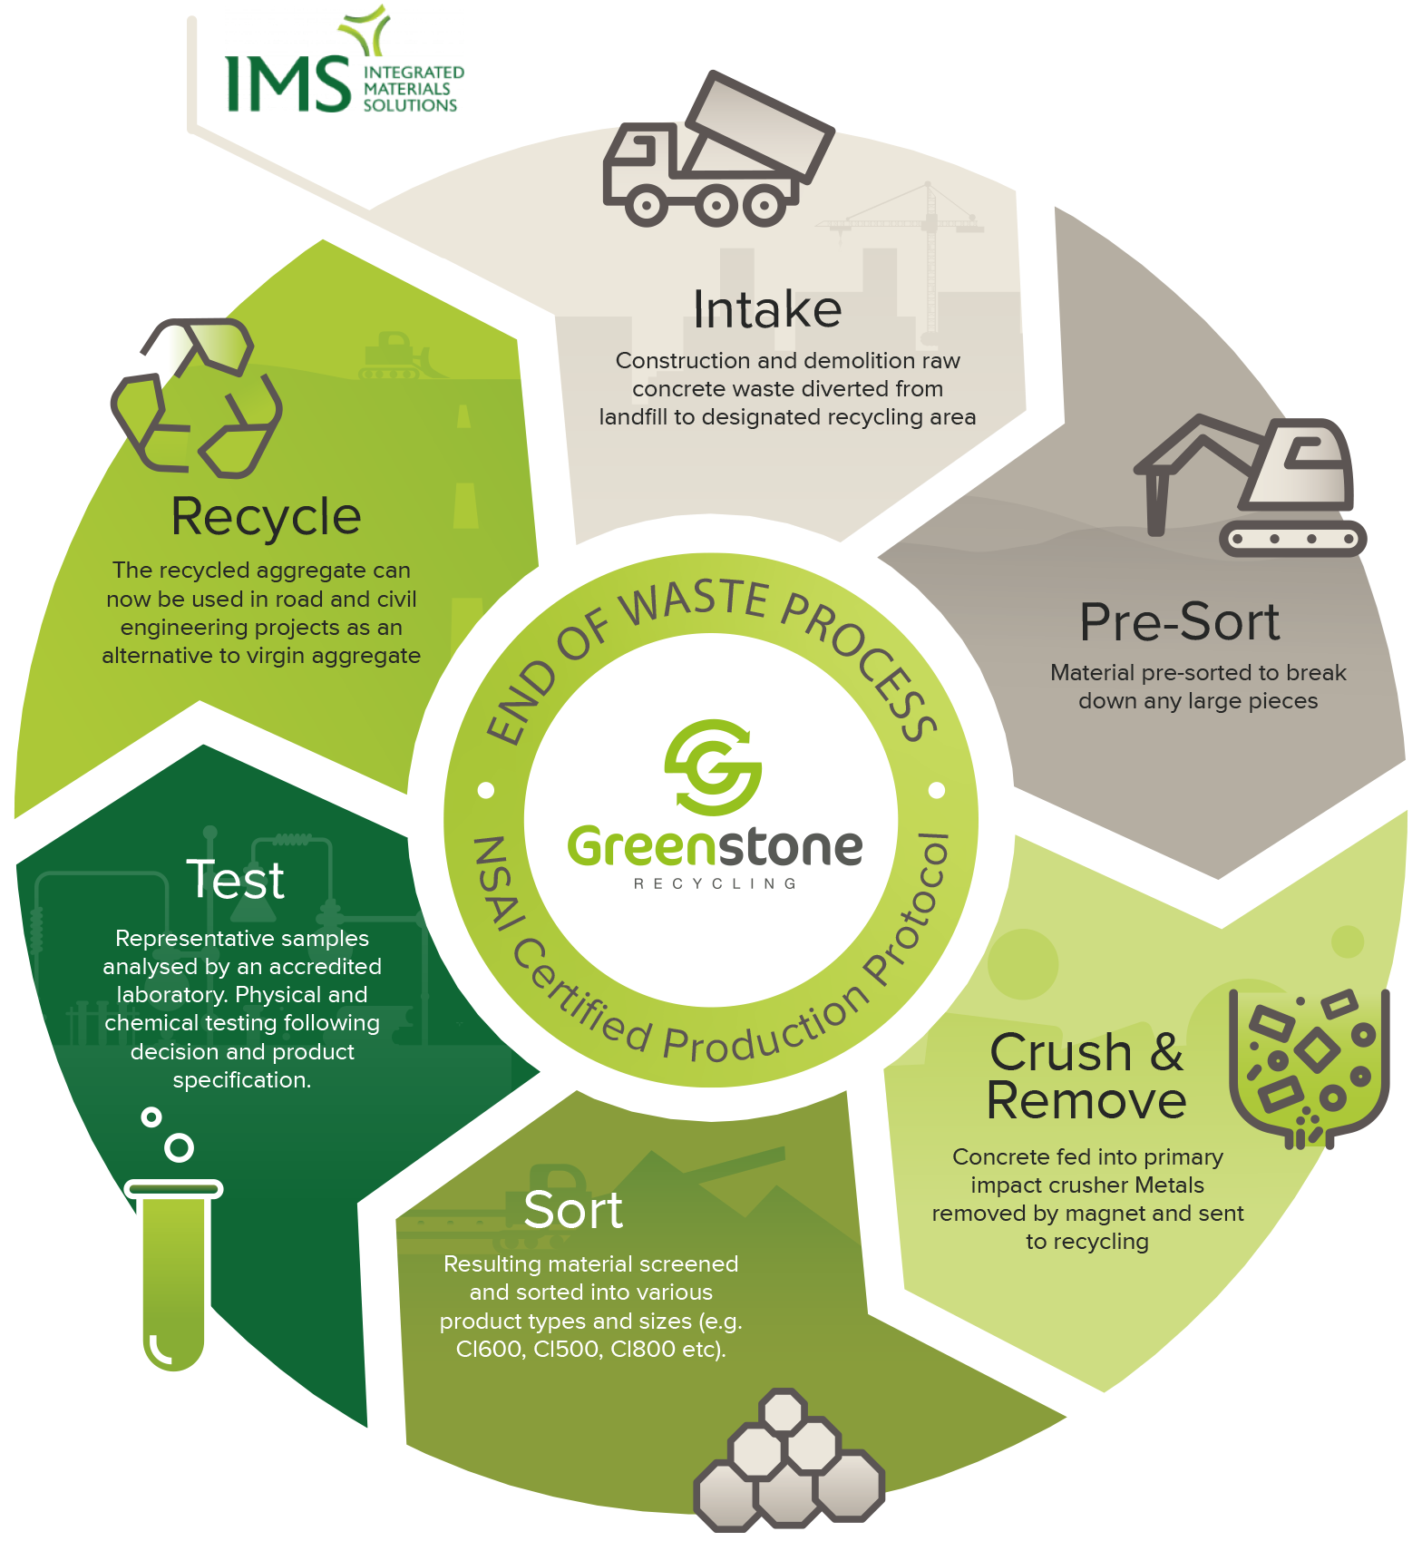
Construction sector
This sector also plays a substantial role in energy-related emissions (39%) and acid rain agents. Sustaining such high greenhouse gas emissions poses significant challenges. Therefore, addressing global climate change and promoting cleaner production must involve the active participation of this industry.
Construction and demolition projects contribute significantly to EU waste, responsible for roughly one-third of total waste generation. Much of this waste ends up in landfills, posing serious environmental issues throughout the building lifecycle, especially during operation and end-of-life stages.
Figure 2. Flow chart of material life cycle
https://www.igbc.ie/circular-thinking-in-construction/
Blended Intensive Programme
Warsaw University of Life Sciences - SGGW
Waste Materials Application in Civil and Environmental Engineering

Slide 4
Circular economy
The Circular Economy (CE) concept, comes from industrial ecology, and combines various pre-existing ideas from multiple scientific domains with shared characteristics. These include industrial ecosystems, the 3Rs principle (reduce, reuse, and recycle), cleaner production encompassing circular material flows in manufacturing systems, product-service systems, eco-efficiency, cradle-to-cradle design, green growth, biomimicry, natural capitalism, social-ecological system resilience, the notion of zero emissions, and more.
Figure 2. Flow chart of material life cycle
https://www.igbc.ie/circular-thinking-in-construction/
Blended Intensive Programme
Warsaw University of Life Sciences - SGGW
Waste Materials Application in Civil and Environmental Engineering

Slide 5
Introductory
Welcome to the course on "Waste Materials Application in Civil and Environmental Engineering." In this course, we explore the innovative and transformative concept of Circular Economy (CE) and its profound impact on the fields of civil and environmental engineering. We will focus on:
Understanding the Paradigm Shift: The concept of the Circular Economy has evolved from a multitude of scientific disciplines, each contributing valuable insights and approaches. It encompasses industrial ecosystems, the 3Rs principle (reduce, reuse, and recycle), cleaner production methods, eco-efficiency, cradle-to-cradle design, and many more. This paradigm shift seeks to replace the traditional "take-make-dispose" model that has posed significant challenges to environmental sustainability.
Figure 2. Flow chart of material life cycle
https://www.igbc.ie/circular-thinking-in-construction/
Blended Intensive Programme
Warsaw University of Life Sciences - SGGW
Waste Materials Application in Civil and Environmental Engineering

Slide 6
Introductory
The Environmental Imperative: The building and construction sector, integral to the global economy, exert substantial influence on the environment. This sector is a significant contributor to resource consumption, energy use, and greenhouse gas emissions. Moreover, construction and demolition activities generate a substantial portion of the EU's waste, which, if not managed sustainably, leads to long-term environmental problems. Here you will learn how to deal with waste materials and how to reuse them instead natural resources.
Figure 2. Flow chart of material life cycle
https://www.igbc.ie/circular-thinking-in-construction/
Blended Intensive Programme
Warsaw University of Life Sciences - SGGW
Waste Materials Application in Civil and Environmental Engineering

Slide 7
Introductory
Course Focus: In this course, we will explore how the principles of Circular Economy can revolutionize the civil and environmental engineering fields. We will look into concepts like toxicology, waste types, testing for geotechnical parameters, and desing. By understanding and applying these principles, you will be equipped to address the challenges posed by the traditional linear economy and work towards a more sustainable, circular approach.
By the end of this course, you will not only be familiar with the theoretical foundations of Circular Economy but also equipped with practical knowledge to apply these principles in real-world civil and environmental engineering scenarios.
Figure 2. Flow chart of material life cycle
https://www.igbc.ie/circular-thinking-in-construction/
Blended Intensive Programme
Warsaw University of Life Sciences - SGGW
Waste Materials Application in Civil and Environmental Engineering

Slide 8
Online part (preparatory week) April 2026
General framework
• Day 1: Introduction to the course, participants' expectations, and goals.
• Day 2: Overview of C&D and ISW materials, their composition, and properties.
• Day 3: Ecotoxicity, environmental impacts, and remediation potential of C&D and ISW materials.
• Day 4: Geotechnical design on C&D and ISW materials subgrade.
• Day 5: Parameters evaluation for geotechnical design. Geotechnical investigation as a tool for soil mechanical and physical properties investigation.
Blended Intensive Programme
Warsaw University of Life Sciences - SGGW
Waste Materials Application in Civil and Environmental Engineering

Slide 9
On-site part
20.04-24.04.2026, SGGW campus, Warsaw, Poland
General framework
Monday: 9am-4pm; welcome meeting, campus tour WePoint SGGW, introduction to BIP Course lecture, toxicology laboratory (coffee breaks provided, lunch break)
Tuesday: 9am-3pm; pavement engineering laboratory testing, consultations (optional), (coffee breaks provided, lunch break)
Wednesday: 9am-3pm; pavement engineering laboratory testing, consultations (optional), (coffee breaks provided, lunch break), Guided tour in Warsaw Old Town 5pm-8pm, Cultural dinner provided 8pm-9pm.
Thursday: 9am-3pm; toxicology laboratory observations-consultations, Geotechnical Parameter Calculation and design, consultations, workshop and team project work on the campus,(coffee breaks provided, lunch break)
Friday: 9am-2pm; Final reports Presentations, Farewall meeting, (coffee breaks provided, lunch break)
Additionally, the opportunity for students to participate in Civil Engineering Days, organized annually by students of the Civil Engineering Scientific Society.
Blended Intensive Programme
Warsaw University of Life Sciences - SGGW
Waste Materials Application in Civil and Environmental Engineering

Slide 10
Maximum number of participants: 20-25
Contact persons:
Prof. Wojciech Sas: wojciech_sas@sggw.edu.pl
Dr Andrzej Głuchowski: andrzej_gluchowski@sggw.edu.pl
Dr Justyna Dzięcioł: justyna_dzieciol@sggw.edu.pl
Dr Katarzyna Gabryś: katarzyna_gabrys@sggw.edu.pl
Blended Intensive Programme
Warsaw University of Life Sciences - SGGW
Waste Materials Application in Civil and Environmental Engineering

Slide 11
WELCOME TO THE COURSE
Blended Intensive Programme
Warsaw University of Life Sciences - SGGW
Waste Materials Application in Civil and Environmental Engineering
Online part: April 2026 (8 hours)
On-site part: 20 – 24 April 2026

